Slide 1
Extraordinary rendition: Abu Zubaydah litigation before the ECtHR
Helen Duffy
Human Rights in Practice
www.rightsinpractice.org; @HelenDuffy_HRP

Slide 2
Abu Zubaydah: “the A-Z of where we went wrong.”

Slide 3
Overview
Key characteristics of the rendition programme & Abu Zubaydah’s situation
Which legal questions arise regarding applicability, which rights and obligations are infringed , where does responsibility lie and why?
Responding to ERP: methods and processes of international law
Focus on the ECtHR:
Preparation and Process; Judgment and Reparation
Reflect on Significance of the programme and responses, and limitations

Slide 4
6 characteristics of the ERP
High Level Authorisation of secret detention for unfettered intelligence gathering
Bush Presidential Memorandum 17 September 2001
Dick Cheney, 16 September 2001:
We also have to work, though, sort of the dark side, if you will. … That’s the world these folks operate in, and so it’s going to be vital for us to use any means at our disposal, basically, to achieve our objective.… we need to make certain that we have not tied the hands, if you will, of our intelligence communities in terms of accomplishing their mission.”
Secrecy
Various manifestations: design, modus operandi, and ‘concerted cover up’
How then do we know? The remarkable uncovering of facts & diverse sources
Torture:
‘standard conditions’ of detention and transfer
‘enhanced interrogation techniques’: conditioning, corrective, coercive
Guarantees of impunity – link to torture
On going Violations
Cooperation and Complicity: The Global ‘Spiders Web’

Slide 5
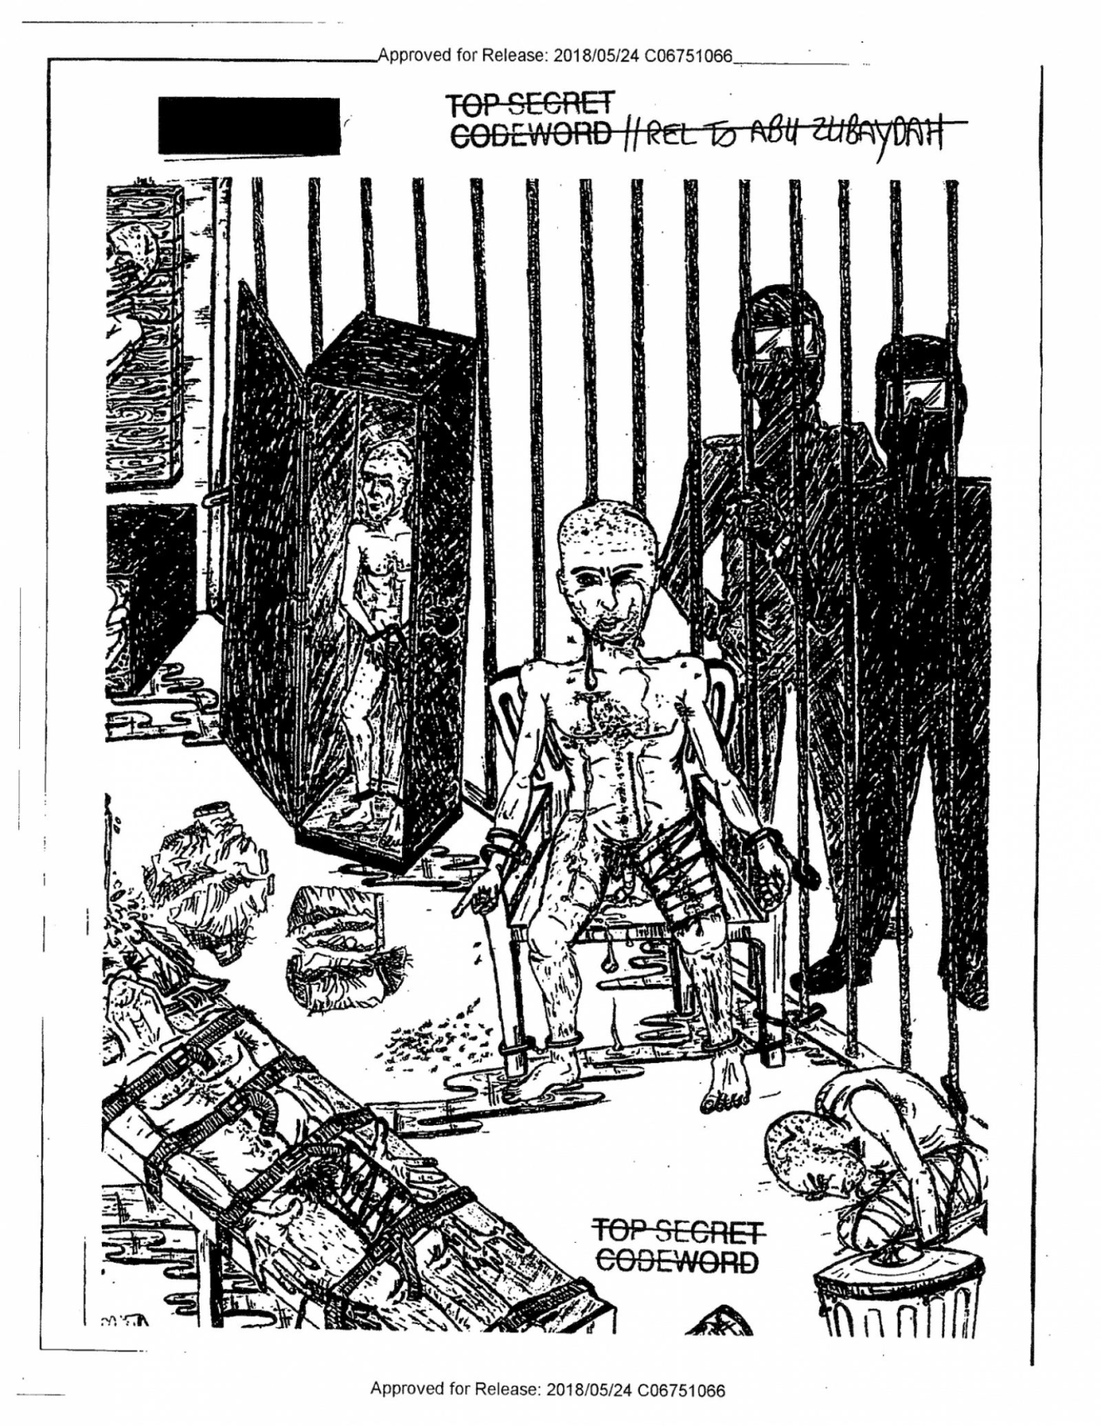
Torture of Abu Zubaydah - “enhanced interrogation techniques” reflected in his drawings published May 2018 “He spent a total of 266 hours (11 days, 2 hours) in the large (coffin size) confinement box and 29 hours in a small confinement box, which had a width of 21 inches, a depth of 2.5 feet, and a height of 2.5 feet,” “The CIA interrogators told Abu Zubaydah that the only way he would leave the facility was in the coffin-shaped confinement box.” “Waterboarding was physically harmful, inducing convulsions and vomiting: abu Zubaydah […] became unresponsive with bubbles rising through his open, full mouth.” … 1001 references to AZ. US Senate Intelligence C/ee report 2014

Slide 6
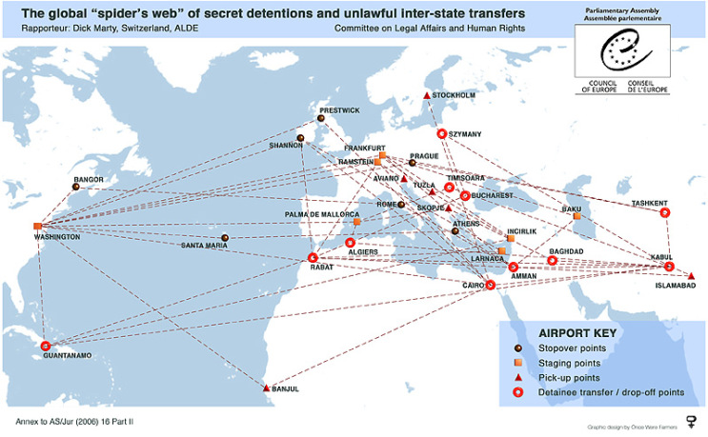

Slide 7
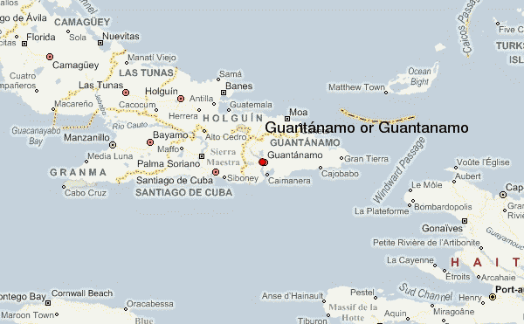
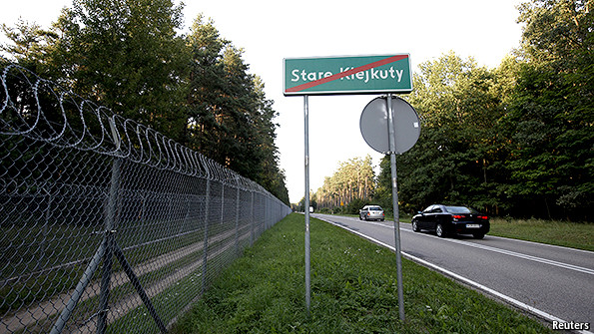
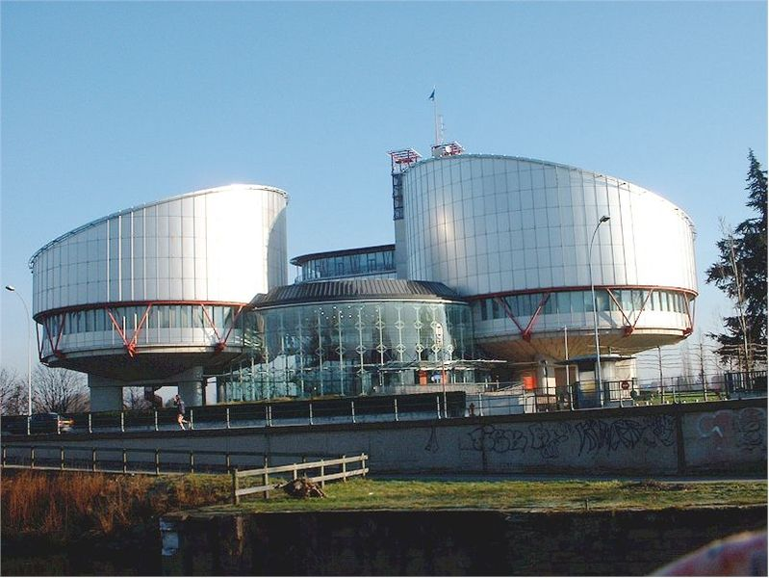
Abu Zubaydah v Lithuania Judgment ECHR 31 May 2018
Abu Zubaydah v Poland Judgment ECHR 2014

Slide 8
Preparing and presenting the case
What do you need to establish?
Admissibility: was the applicant within the jurisdiction? Are domestic remedies exhausted?
Responsibility: failure of positive obligations will suffice
Standard and burden of proof: ‘beyond reasonable doubt’ (ish)
Where prima facie evidence, and the government offers only “firm denials” and fails to provide any “satisfactory and convincing explanation….” then “strong and concordant inferences of fact could be drawn (paras 482, 488).”
Evidence? As it unfolded during the case…
Flight information: paths, plans, contracts;
Treatment of applicant: authorized techniques, those in use elsewhere, of others at the relevant time and place, no smoking gun
Knowledge;
Agreement, cooperation, facilitation;
failure of domestic investigation.

Slide 9
The Judgment (31.5.2018)
Findings of Fact
Conclusions of Law
ERP “anathema to the rule of law and the values protected by the Convention”.
Violations?
Torture, cruel inhuman and degrading treatment
Arbitrary detention
Non-refoulement: to arbitrary detention, inhumane treatment (fair trial- Poland)
Right to private and family life
Right to a remedy; failure to investigate, truth and accountability
“the right to the truth regarding the relevant circumstances of the case does not belong solely to the victim of the crime and his or her family but also to other victims of similar violations and the general public, who have the right to know what has happened.

Slide 10
Reparation and damages: innovation
The conservative ECtHR approach and push for appropriate reparations
Decision:
Damages award
Representations to the US
“by enabling the transfer of the applicant to another CIA detention site, the Lithuanian authorities exposed him to a foreseeable risk of continued secret, incommunicado and otherwise arbitrary detention, liable, in his case, to continue for the rest of his life, in breach of Article 5 […] as well as to further ill-treatment and conditions of detention, in breach of Article 3 […]in the opinion of the Court, the treaty obligation of Lithuania under Article 46 of the Convention to take the necessary individual measures to redress as far as possible the violation found by the Court, require that the Lithuanian authorities attempt to make further representations to the US authorities with a view to removing or, at the very least seeking to limit, as far as possible, the effects of the Convention violations suffered by the applicant” (para 681).
Investigation and Accountability
“an ongoing failure to provide the requisite investigation will be regarded as a continuing violation”(para 682).
Now to Implementation…?

Slide 11
Reflections on Implications and Limitations?
For Truth, Accountability and Reparation?
Practice to date?
Impunity rules
Unprincipled approaches to Reparations
For Historical Record & Reckoning? Longer-term rule of law implications? Non repetition?
For Abu Zubaydah?
Small piece bigger puzzle

